Slide 1

Homework Assignment for Business Intelligence Lead
Rafael Fagundes
Dec 2024

Slide 2

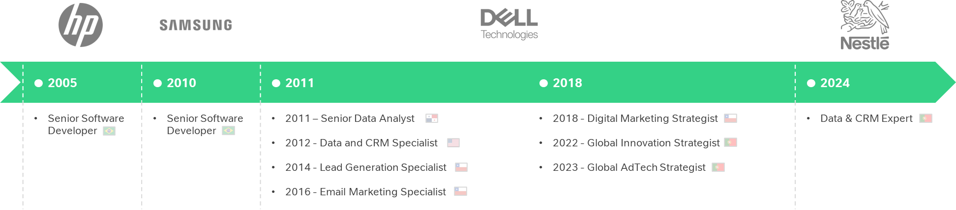
About me
Rafael Fagundes
Lisbon, Portugal
Computer Engineer
linkedin.com/in/rsfagundes | rsfagundes.com
With 10+ years in data analysis and marketing, I specialize in scalable solutions and automation using tools like SQL and Python.

Slide 3
Monthly MI Pack: Payment Operations Performance and Insights Report

Slide 4
Considerations
This analysis reviews performance data from Global Payments Processing and Regional Payment Operations over the past six months. It highlights monthly and quarterly insights through clear visuals, uncovering patterns, trends, and key data points. The findings are explained with commentary, supported by actionable recommendations to drive improvements and share learnings across teams.
The biggest challenge was understanding the dataset, its definitions, and how to apply it effectively. Below is my interpretation of the data:
Dataset Name | Description | Fields
Global linking wait time bucket | Contains data about wait times for global linking operations, categorized into specific time buckets. | Action Created Parameter, Wait Hour Buckets (1. Within 1h, 2. Within 2h, ..., 9. Over 72h), Case Count
Global linking escalations and | Includes information about escalations in global linking operations, along with rates of escalation. | Action Created Parameter, No of Escalations, Escalation Rate
Global DU wait time buckets | Contains wait time data for Global DU (DocUpload) operations, grouped by specific time ranges. | Action Created Parameter, Wait Hour Buckets (1. Within 1h, ..., 8. Within 72h), Ticket Count
Global DU escalations and escal | Provides data on escalations in Global DU (DocUpload) operations, including rates and counts of escalation. | Action Created Parameter, No of Escalations, Escalation Rate
Regional NM & ACH inputs by tea | Details the queue inputs for regional Name Mismatch (NM) and ACH (Automated Clearing House) operations. | Ops Team Currency, Action Created Parameter, Queue Input Count (e.g., APAC Expansion ops, NorthAm ops)
Regional NM & ACH outputs by te | Provides data on outputs for regional NM and ACH operations, including counts and team-level metrics. | Internal Action Actor Payops Team, Action Created Parameter, Output Count (e.g., GBP ops, NorthAm ops)

Slide 5
Understanding Performance by Wait Time Buckets Highlights SLA trends, with Global Linking excelling and Global DU facing delays in longer buckets.
 | Global (Linking + DU) |  |  |  |  |  | Global DU |  |  |  |  |  | Global Linking
Wait Time Bucket | May | June | July | August | September | October | May | June | July | August | September | October | May | June | July | August | September | October
1. Within 1h | 49% | 24% | 21% | 14% | 12% | 38% |  | 32% | 24% | 10% | 7% | 32% | 49% | 23% | 20% | 15% | 13% | 39%
2. Within 2h | 23% | 14% | 15% | 12% | 13% | 23% |  | 13% | 14% | 8% | 9% | 18% | 23% | 14% | 15% | 13% | 14% | 24%
3. Within 4h | 14% | 27% | 20% | 19% | 21% | 22% |  | 15% | 17% | 10% | 17% | 23% | 14% | 29% | 20% | 21% | 22% | 22%
4. Within 8h | 8% | 21% | 19% | 27% | 27% | 12% |  | 18% | 18% | 25% | 24% | 17% | 8% | 21% | 19% | 28% | 28% | 11%
5. Within 12h | 1% | 6% | 8% | 10% | 10% | 2% |  | 7% | 8% | 14% | 15% | 5% | 1% | 6% | 8% | 9% | 9% | 2%
6. Within 24h | 1% | 3% | 10% | 11% | 13% | 2% |  | 5% | 11% | 19% | 19% | 5% | 1% | 3% | 10% | 9% | 11% | 2%
7. Within 48h | 4% | 4% | 5% | 5% | 4% | 1% |  | 6% | 6% | 7% | 9% | 2% | 4% | 3% | 5% | 5% | 3% | 0%
8. Within 72h | 1% | 2% | 2% | 2% | 0% | 0% |  | 4% | 2% | 6% | 0% | 0% | 1% | 1% | 2% | 2% | 0% | 0%
9. Over 72h | 0% | 0% | 0% | 0% | 0% | 0% |  | 0% | 0% | 0% | 0% | 0% | 0% | 0% | 0% | 0% | 0% | 0%
Insights | Recommendations
1-Hour Bucket: Global Linking leads, peaking at 49% (May) and 39% (October). Global DU varies (10% in August to 32% in October). October shows improved Instant SLA via Global Linking. 4-Hour & 8-Hour Buckets: Both types depend on these buckets. Global DU peaks at 25% (August, 8-hour). Global Linking remains stable and efficient. Longer Buckets: Global DU struggles with 24-hour and 48-hour cases in August and September. Global Linking experiences fewer delays. MoM Trends: October improves for short buckets. August performs poorly, especially for Global DU. Over 72 Hours: Minimal usage, showing a focus on resolving cases within 24 hours. | Short Buckets: Use Global Linking strategies to improve DU’s 1-hour performance. 4-Hour & 8-Hour Buckets: Optimize workflows to prevent cases from spilling into longer buckets. DocUpload Delays: Fix processes to reduce 24-hour and 48-hour cases in Global DU. Stabilize: Sustain October gains and address drops like those in August. Monitor: Track delays and tackle root causes across all buckets promptly.

Slide 6
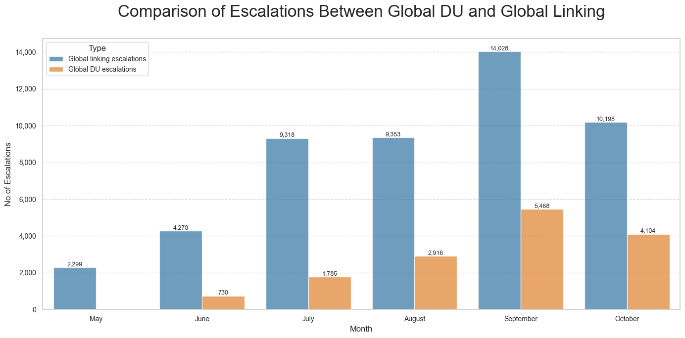
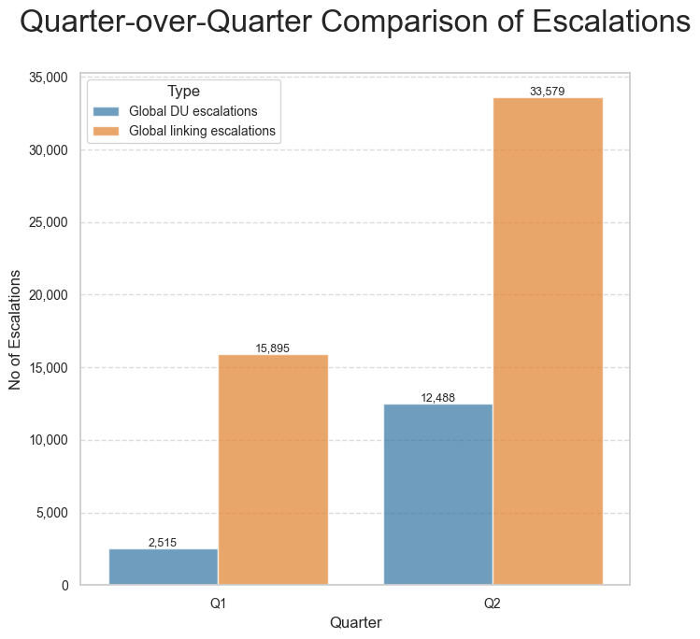
Uncovering Escalation Trends Across Teams Reveals escalation peaks, with September as a critical month and opportunities to improve resolution.
Insights | Recommendations
Monthly Trends: September is critical, with 14,028 Linking and 5,468 DU escalations, improving slightly in October. Quarterly Trends: Linking escalations doubled in Q2 (30,383), while DU rose fivefold (12,488). Performance Gaps: Widening gap between Linking and DU, highlighting inefficiencies in DU. | Fix September: Address root causes of peak escalations. Streamline DU: Improve workflows to reduce the gap with Linking. Sustain Gains: Build on October's progress to lower escalations further. Plan Ahead: Use Q2 insights to forecast and manage future workloads.

Slide 7
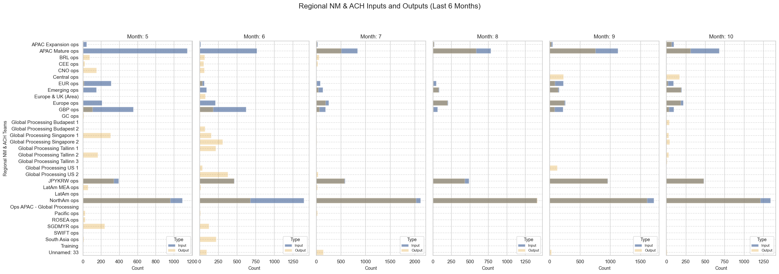
Comparing Regional Inputs and Outputs Analyzes team efficiency, highlighting NorthAm and JPYKRW as leaders and identifying areas for optimization.
Insights | Recommendations
NorthAm Ops: Leads in inputs and outputs, peaking in September and October. JPYKRW Ops: Balanced inputs and outputs, showing efficiency. APAC Mature Ops: High inputs, low outputs, indicating inefficiency. GBP Ops underperforms consistently, with declining inputs and a persistent gap between inputs and outputs. | NorthAm Ops: Allocate resources to maintain high consistency and sustain strong performance. JPYKRW Ops: Scale operations to capitalize on the growth in inputs and outputs. APAC Ops: Continue efforts to balance inputs and outputs by optimizing workflows. Monitor Trends: Replicate success of NorthAm and JPYKRW Ops in other teams.

Slide 8
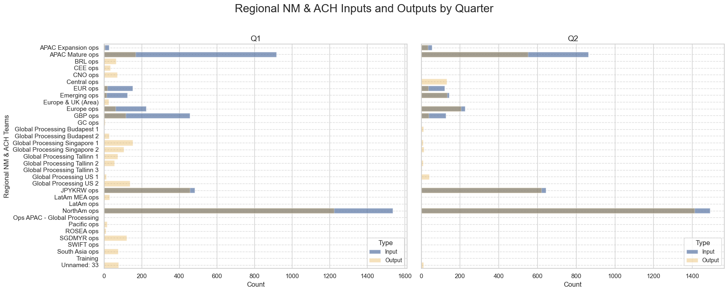
Comparing Regional Inputs and Outputs Analyzes team efficiency, highlighting NorthAm and JPYKRW as leaders and identifying areas for optimization.
Insights | Recommendations
Comparing quarterly data, NorthAm Ops shows consistent performance, while JPYKRW sees growth in both inputs and outputs. APAC reduces the gap between inputs and outputs. EUR and Emerging Ops show progress, narrowing their gaps. Europe Ops and GBP exhibit weaker performance. | EUR and Emerging Ops: Build on recent progress by improving processes to fully close the gap. Europe Ops and GBP: Investigate root causes of lower performance and implement strategies to enhance efficiency and throughput.

Slide 9

Driving Operational Excellence: Key Insights and Strategic Actions Implement these data-driven strategies to optimize performance, enhance efficiency, and align teams with organizational goals.
Key Insights | Actionable Recommendations
Global Linking Efficiency: Outperforms DU in short SLA buckets, yet DU struggles in longer cases (24-48 hours). September remains a critical escalation month. Regional Leaders: NorthAm leads consistently; JPYKRW shows steady growth and efficiency. Underperforming Areas: Europe Ops and GBP lag behind, with declining inputs and persistent gaps. Trends Over Time: APAC narrows input-output gaps; Emerging Ops and EUR show gradual improvement. | Resolve Escalation Peaks: Focus on September's root causes and optimize DU’s workflows. Improve Wait Times: Apply Global Linking strategies to reduce delays in DU's longer buckets. Support Lagging Teams: Address Europe Ops and GBP inefficiencies with targeted process improvements. Leverage Insights: Use quarterly trends to predict workloads and enhance operational efficiency.

